Slide 1
Micro Markets & Vending
Best Option for Covid-19
April 2020

Slide 2
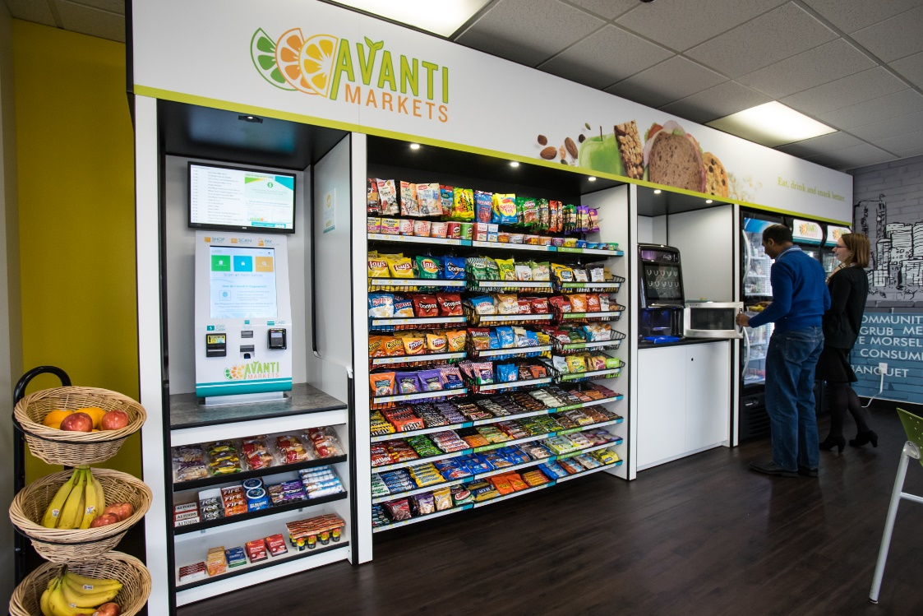
IS AN Open-air micro market more likely to spread a virus than vending?

Slide 3
Comparison
Protection Provided | Micro Markets | Vending
No Touch Transaction at Kiosk? | Yes – via Mobile or physical market card scan | Need to touch buttons to select products Need to swipe card or pay cash in most instances
No Touch Product? | Possibility that a customer could sneeze or cough on packaged food that is on the racks or in the coolers Signage & communications can help promote best practices (e.g. take what you touch, wear mask when shopping) | Since product is behind glass, it is perceived as no touch, but you still need to reach into the dispensing bin. Every customer has to reach into the same slot!
Can Retrofit for Improved Virus Protection? | Option to use a product like https://www.nanoseptic.com/ to address cooler door handles | Not aware of any solutions
Product Merchandising? | Comparable – Both scenarios require someone to touch (pick up and place) product when stocking
Micro Markets vs. Vending - Best Option for Preventing Covid-19 Exposure?
ISSUE: A client believes that the open-air micro market is more likely to spread a virus than vending.
 | Avanti Micro Markets | Vending Machines
Ability to purchase without touching kiosk | Yes - via Mobile or physical market card scan | Need to touch buttons to select products; Need to reach into dispensing bin to obtain product. Have you seen how dirty these can be :-?
REALITY: Both vending machines and micro markets have limitations around sanitation. We recommend best practices for making micro markets the optimal solution.

Slide 4
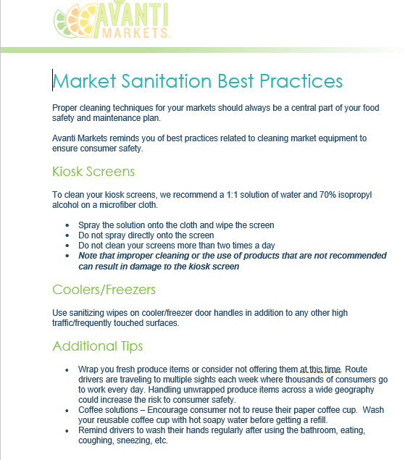
REALITY: Both vending machines and micro markets have limitations around sanitation.
We recommend best practices for making micro markets the optimal solution
Tools & Resources available on the Avanti Institute https://avanti.knowledgeanywhere.com
Notes:
Intelligence is the key feature

Slide 5
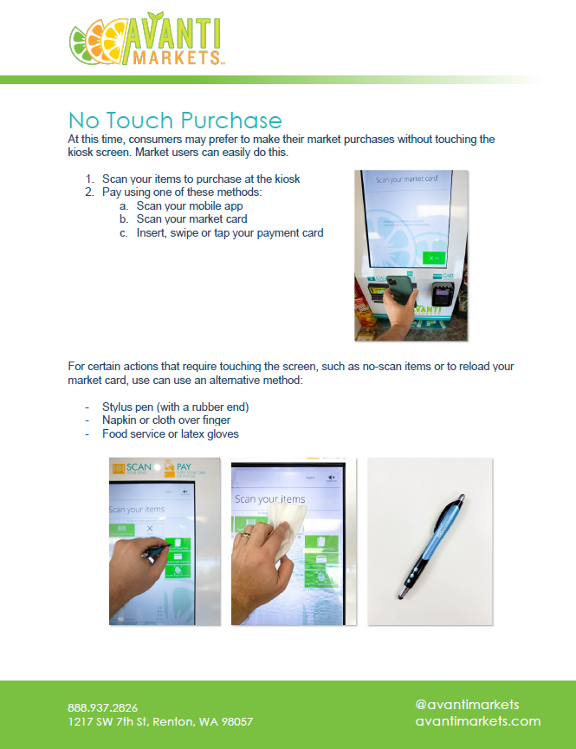
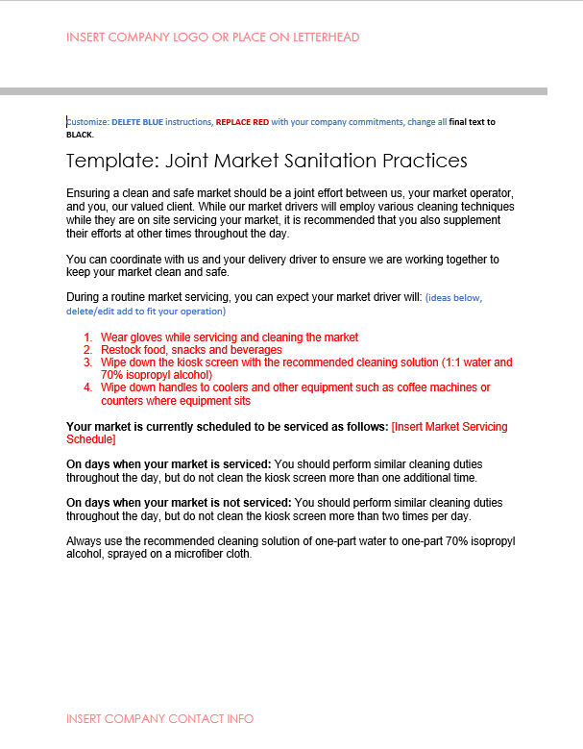
Market & Client Communication Best Practices
What do you need to be thinking about and addressing for your customers?
Sanitation
Servicing schedule
Tips for Users
Template and ideas for how to communicate with host locations and end-consumers
No–touch purchase
Joint sanitation with your host
Showing them what you are doing in their markets and in the location facilities
Tools & Resources available on the Avanti Institute https://avanti.knowledgeanywhere.com
Notes:
Intelligence is the key feature

