Slide 1
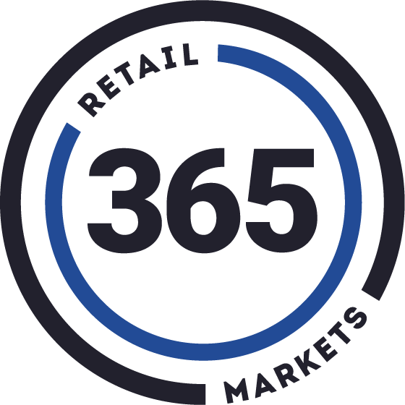
ADM Async Promotions
CONFIDENTIAL - 365 Retail Markets

Slide 2
Agenda
Promo Overview
Historical Usage
Reasoning for Updates
Updated Usage
User Impacts
2
CONFIDENTIAL - 365 Retail Markets

Slide 3
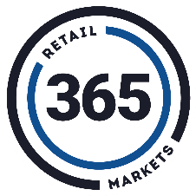
Promo Overview
3

Slide 4
Types of Promotions
Promotions allows Operators to influence consumer behaviors in terms of what items are purchased and when they are purchased
Three available Promotion types:
Tender: Payment method based
On-Screen: Particular Items/Categories
Bundle: Groups of Items/Categories
Promotions discount transactions or products by a percentage or flat amount
Operators can set various criteria:
Orgs
Locations
Tender type
Products
Timeframes
Consumer Roles

Slide 5
Historical Usage
5

Slide 6
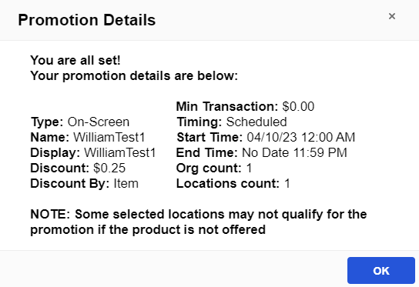
How Promotions Worked
Within ADM, Operators setup all applicable Promotion criteria:
Type
Orgs/Locations
Applicable Items/Categories
Discount Amount
Timing
User submits Promotion
ADM begins to process the promotion within the UI, running all conflict checks and setting up the promotion
There are conflict checks to ensure that the same promotion isn't setup multiple times (by location, product, tender, timeframe)
ADM runs through the entire promotion to determine if it can be setup and applied

Slide 7
How Promotions Worked...
Again, the processing is happening real-time, right within ADM
As soon as ADM has processed the promotion, the User will receive feedback on the results
If there were no conflicts or issues, the promotion is successfully created and ready to start running
If there were conflicts or issues, the promotion is not created, and the user must exit or update the conflicting criteria and try again
For example, the user may need to change the applicable locations, selected products, or the timing of the promotion
At any point after the promotion was created, the User could go back into ADM, make adjustments, and submit the promotion again

Slide 8
Why Make Updates?
8

Slide 9
Why Make Updates to Promos?
As we continue to add more Orgs, Locations, and Products to ADM, we have to become more scalable and service oriented
APIs are a more reliable and effective method to take actions as opposed to just within the UI
Similarly, reducing the load on ADM an moving it to services will help ADM performance as a whole
We need to allow Operators of all sizes to create and process any promotion they come up with, making the functionality usable and more reliable
Eliminate long wait times and promotions timing out when trying to create them

Slide 10
Updated Flow
10

Slide 11
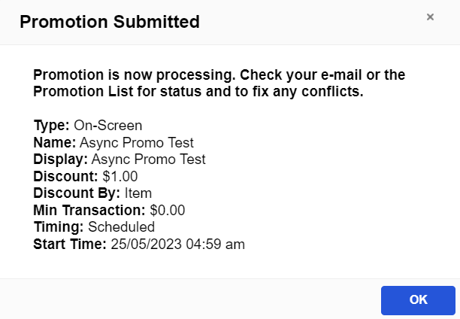
Updated Promotion Flow
Within ADM, Operators setup all applicable Promotion criteria:
Type
Orgs/Locations
Applicable Items/Categories
Discount Amount
Timing
User submits Promotion
At this point, the promotion flow completely changes in terms of the UI and UX
The User is notified that the promotion has been submitted, but the promo does NOT start to process
The promotion goes into a processing queue and will be addressed in a chronological order
Promotions get processed in a first in, first out method
There is a dedicated queue for Flash Sales

Slide 12
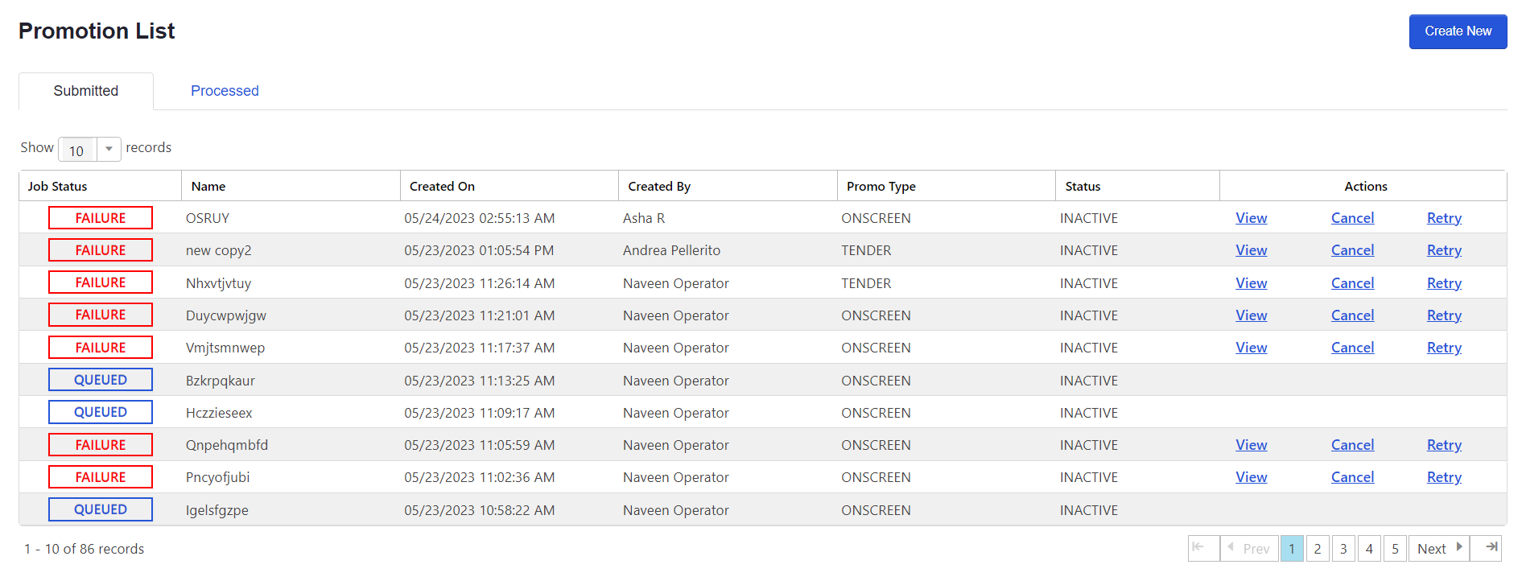

Slide 13
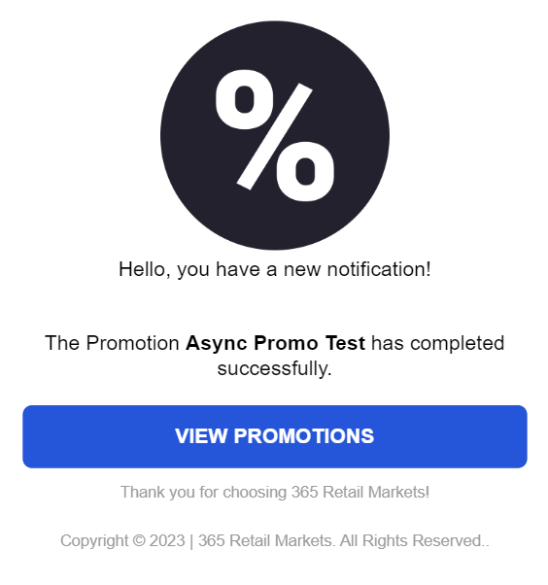
Updated Promotion Flow...
When the promotion's spot in the queue is reached, it will begin processing to check for conflicts and will attempt to implement
If the processing is successful, the promo is created and ready to go
If the processing is unsuccessful, the promo “fails” and must be updated or cancelled
A user must ultimately make adjustments to the promotion and submit for another processing, or Cancel the promo
The User who submitted the promotion will receive an email stating if the promo is successful or unsuccessful
Additionally, there is new UI throughout ADM that shows all Users the status of the promo

Slide 14
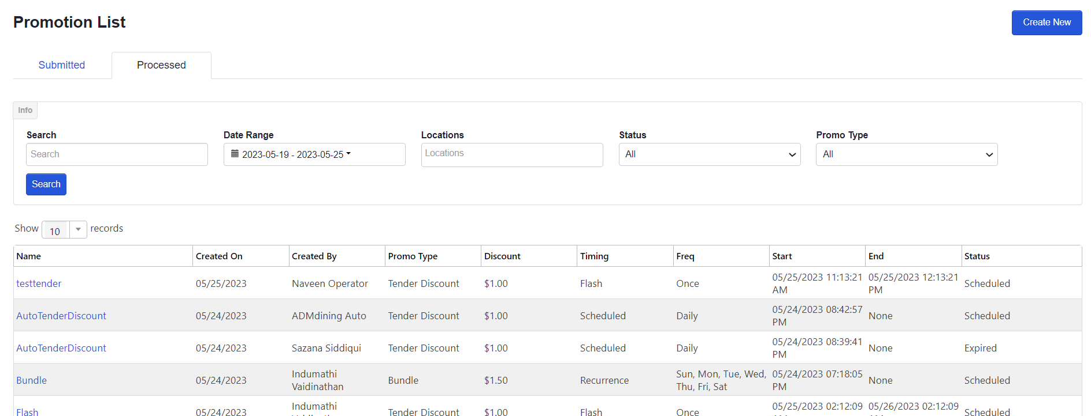

Slide 15
Updated ADM UI
Since there are vast differences now in how and when promotions are processed, ADM UI has been updated in numerous spots to communicate this
The submit promo modal is updated with additional detail on this process
The Admin > Promotion page now is multi-tabbed
Submitted: Shows promotions in the queue that are waiting, processing, or failed
Processed: Shows promotions that are successfully processed and active
When a promotion successfully processes, it moves from the Submitted to the Processed tab
Users can View, Cancel, or Retry Submitted promotions
The create/edit promo flow will show detailed conflicts that prevent the promo from processing
Users can make the necessary edits and submit the promo again for processing

Slide 16
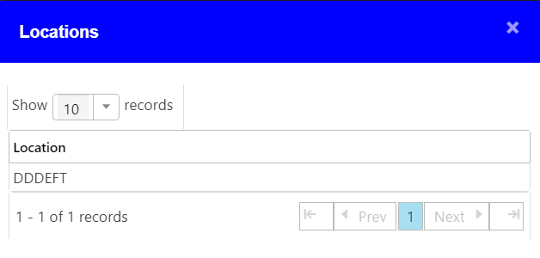

Slide 17
User Impacts
17

Slide 18
User Impacts
Promotions are no longer processed real-time when submitted
Users must be more engaged with the process now to verify if the promotion has actually been implemented
Users gain insights into promotions via the updated ADM UI and new confirmation emails
Existing promotions can still be edited, however the adjustments must be processed as well
Promotion stays active but the changes are not implemented
These updates will allow Operators of all sizes to create and apply promotions as needed
Releasing in late June

Slide 19
Questions?
19

