Slide 1
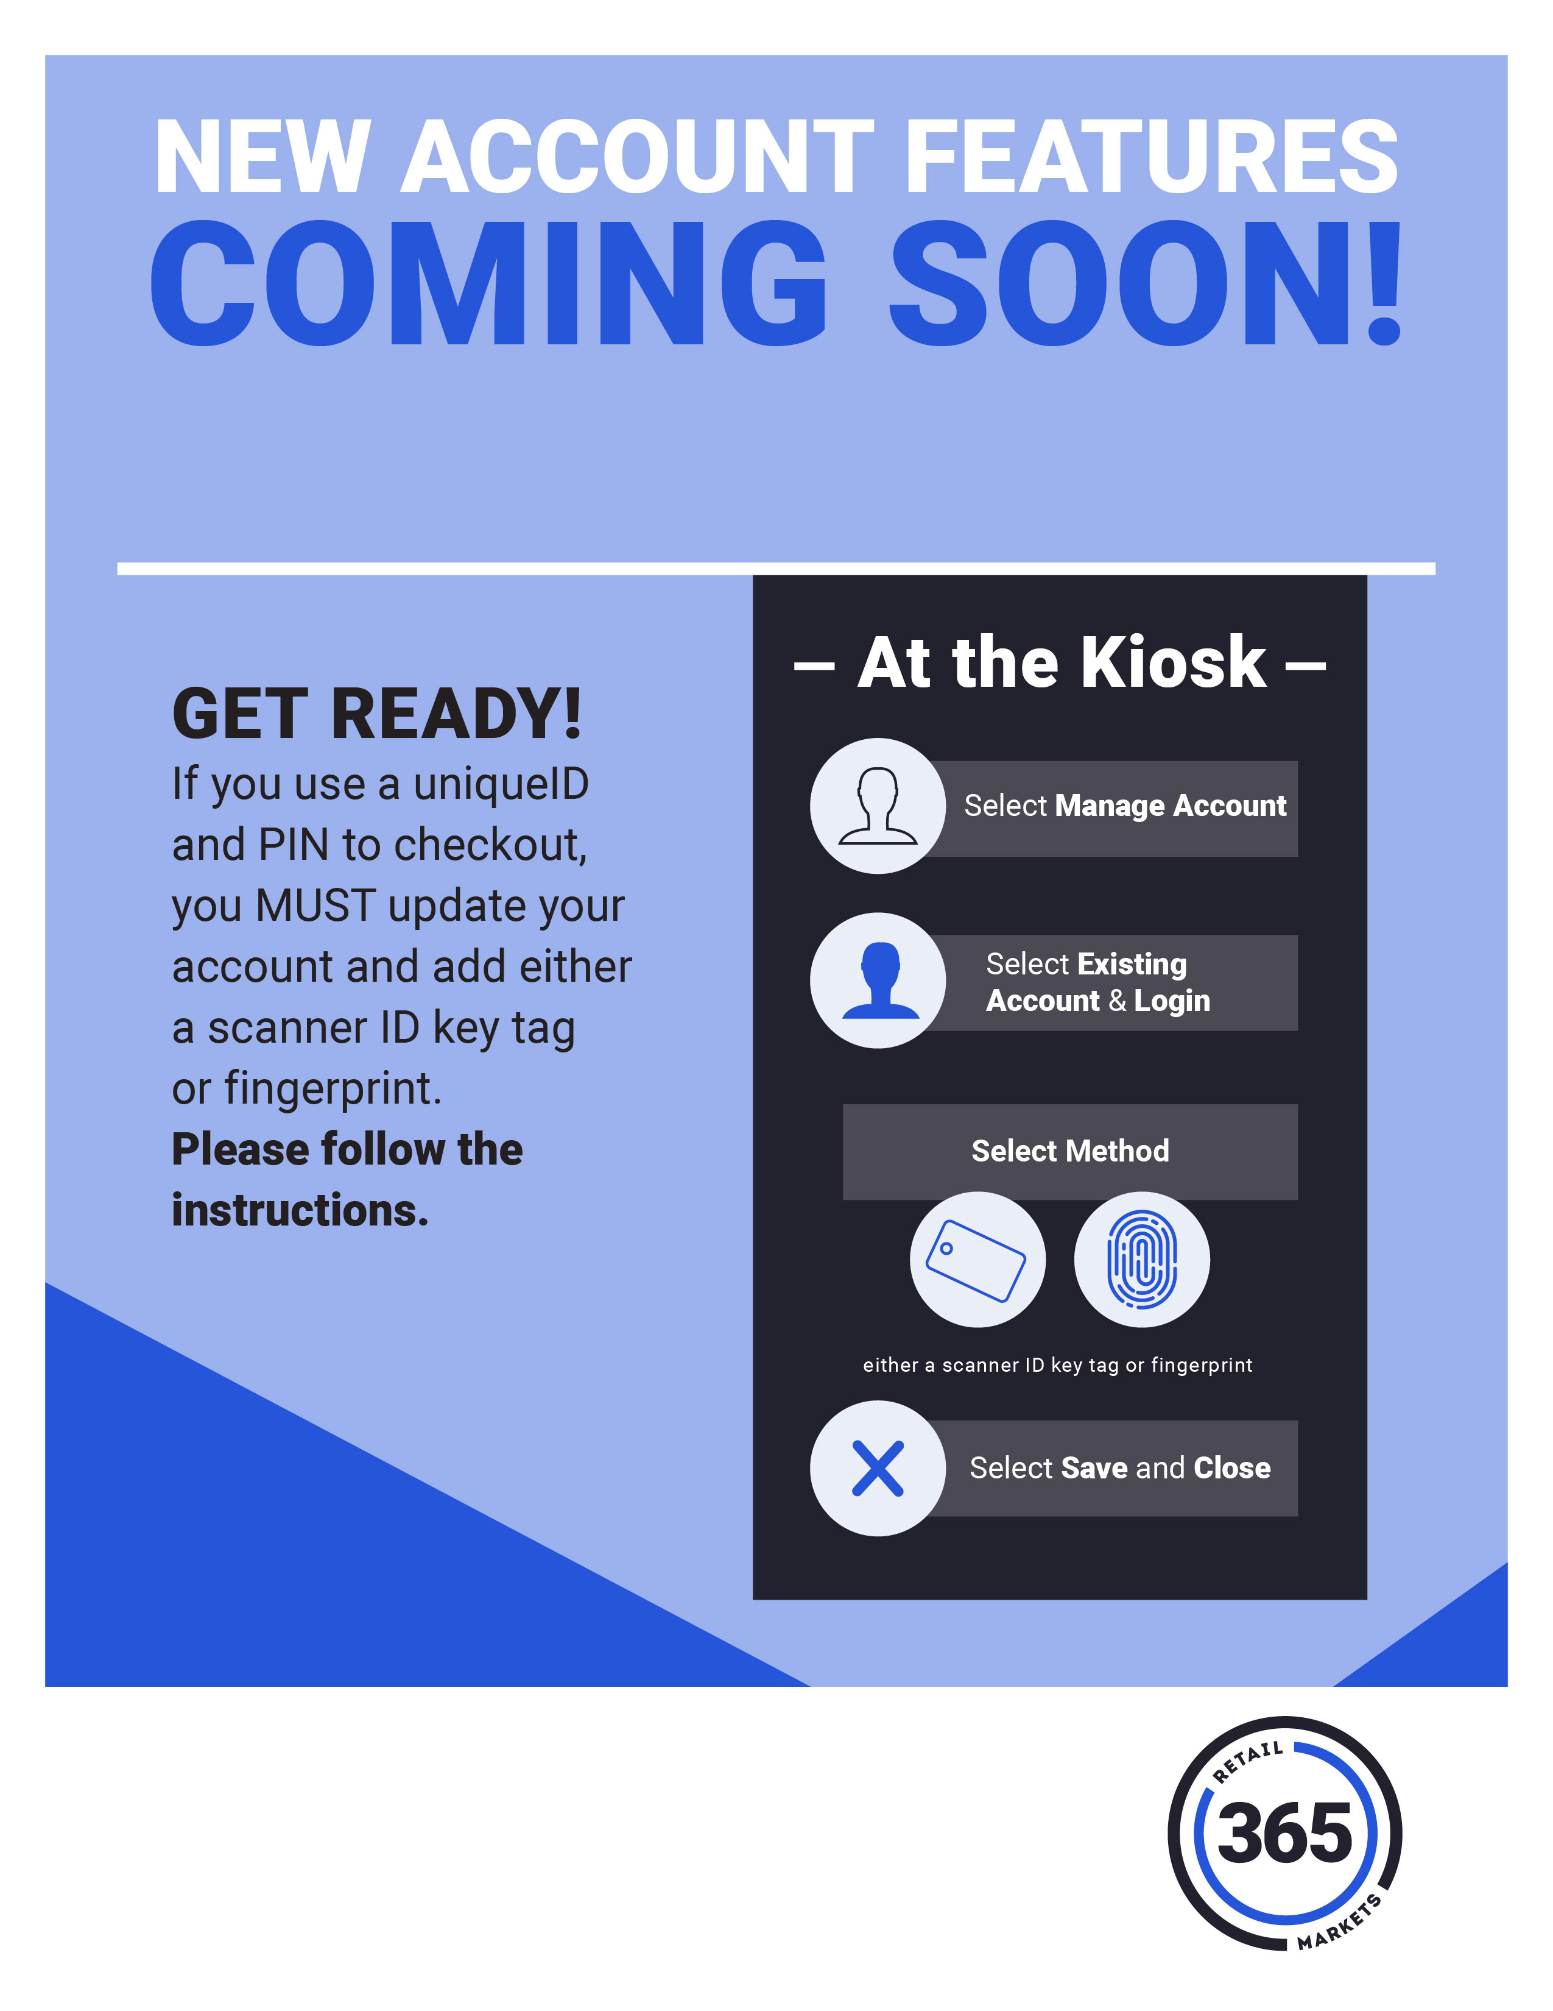
- 00/00/18 -
To continue shopping with us after the upgrade, please upgrade your account by 00/00/2018.

